Slide 1
Compiling to WebAssembly
Seminar project by Vincent Hofer
Assisted by Manuel Leuenberger & Oli Flückiger

Slide 2
Project goals
Explore parser generators and WebAssembly specification
Build a compiler pipeline targeting WebAssembly
Develop a new simple language without prior compiling knowledge

Slide 3

What is WebAssembly?
“WebAssembly is a new type of code that can be run in modern web browsers. It is a binary instruction format for a stack-based virtual machine”
Near-native performance
Supported by all main browser manufacturers
Has a textual representation, besides binary format
Intended as compilation target for languages like C/C++

Slide 4
WebAssembly Text Format
def main { var x; x = 5; call foo(x); }; def foo(num) { num*2; }; | (module (func $main (result f64) (local $x f64) (set_local $x (f64.const 5)) (call $foo (get_local $x)) ) (func $foo (param $num f64) (result f64) (f64.mul (get_local $num)(f64.const 2)) ) (export "main" (func $main)) )

Slide 5
Development of my language and compiler
Iteration 1
2*3+(1+2)/3

Slide 6
Development of my language and compiler
Iteration 2
var x;
x = 3;
x + 2;

Slide 7
Development of my language and compiler
Iteration 3
def main{
var a;
a = 3;
call add(a)(2);
};
def add(x)(y){
x+y;
};

Slide 8
Development of my language and compiler
Iteration 4
def fib(x) {
if (x<=2) {
x=1;
} else { x = call fib(x-2) + call fib(x-1); };
x;
};

Slide 9
Development of my language and compiler
Iteration 5
def main {
var x;
x = 3;
array a [1 2 x 4 5];
len a + get a [2];
};

Slide 10
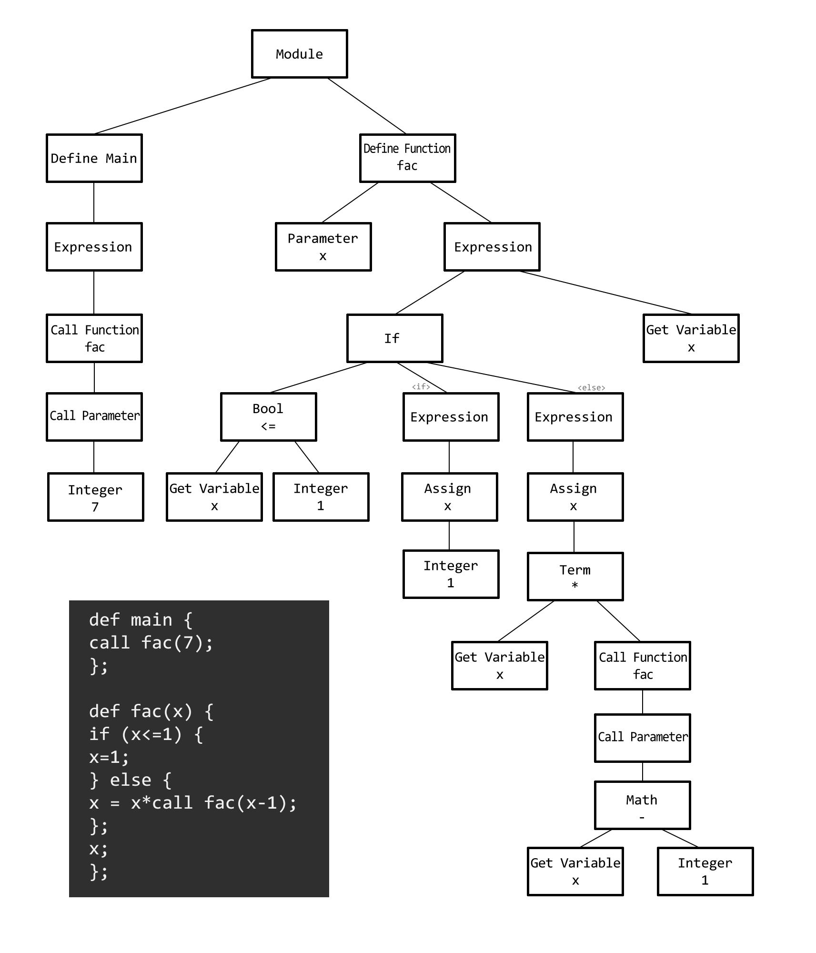
Parser and AST
Parser generator: PEG.js
In the beginning: Direct output of text format
Later: Secondary step through AST

Slide 11
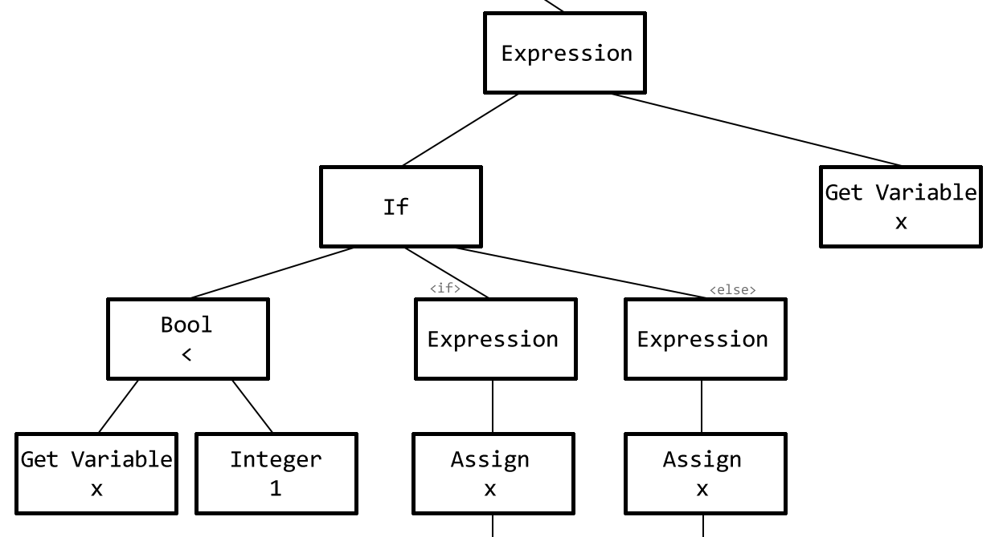
Parser and AST

Slide 12
Squareroot implementation
WebAssembly Compiler Suite by Manuel Leuenberger

Slide 13
WebAssembly vs. JavaScript
def fib(x) {
if (x<=2) {
x=1;
} else {
x = call fib(x-2) + call fib(x-1);
};
x;
};
function fib(x) {
if (x <= 2) return 1;
return fib(x-2) + fib(x-1);
}

Slide 14
Summary
WebAssembly can be used alongside JavaScript
Learned about compilers, grammars and ASTs
Wrote a language targeting WebAssembly
Compiler can be expanded in the future, e.g.
Data types
Strings
Objects
Source of image in slide 3: https://en.wikipedia.org/wiki/WebAssembly

